Slide 1
Section 3.6 Derivatives of Logarithmic Functions
Lecture 1
The power of logarithms

Slide 2

Homework Submission to Canvas
Preview of section
Skim the section in text and write a short paragraph summary.
Give a bulleted list of all important definitions, theorems, and formulas without details.
Notes on video lectures
Take notes on everything written on slides including all details, worked examples, on-own activities, as well as your own thoughts and questions.
Try on-own activities first, then write down provided solution next to it for comparison.
Worked examples from the text
Write down the problem and attempt without looking at the solution.
Use the solution to write the best explanation you can.
Solutions to textbook exercises
Model approaches and explanations given in the video lectures and textbook examples.
Final reflection of section
List the key takeaways to remember as a bulleted list.
Video reflection (for some sections)
Write a 1 paragraph reflection on the video discussing what you found most interesting or useful.

Slide 3
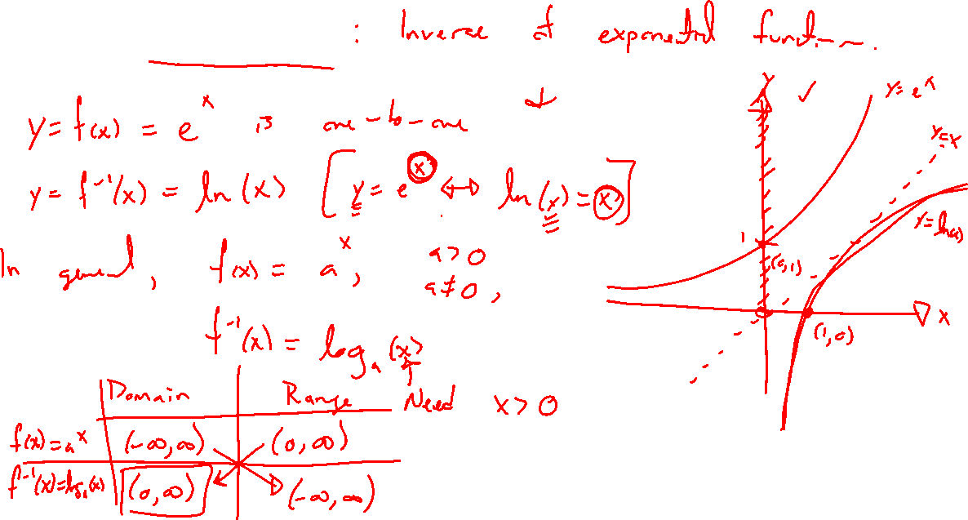
Recall: Logarithms
Notes:
Inverse of exponential, graph, domain and ranges
Wiki history of logarithms

Slide 4

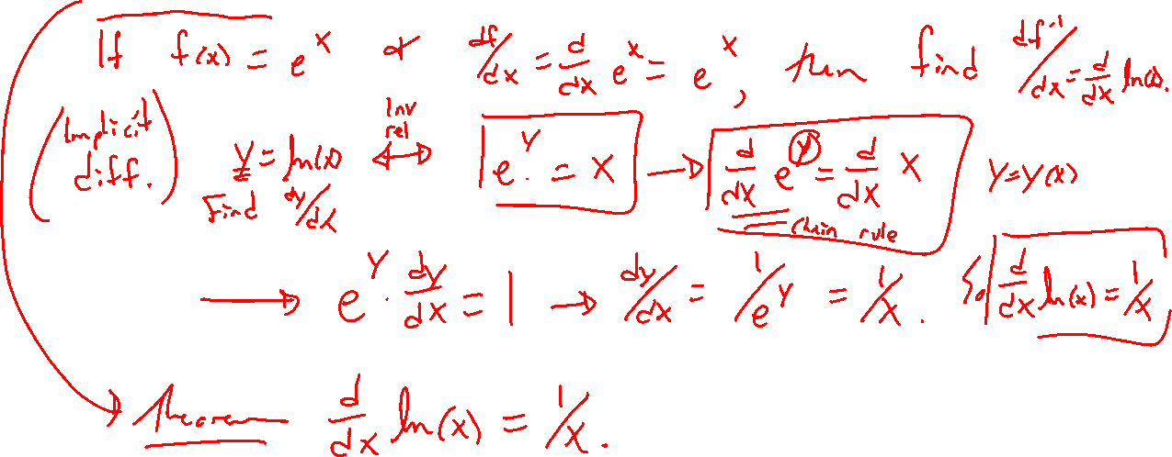
Theorem: Derivatives of logs
Notes:
Natural log as inverse of e^x
General case

Slide 5
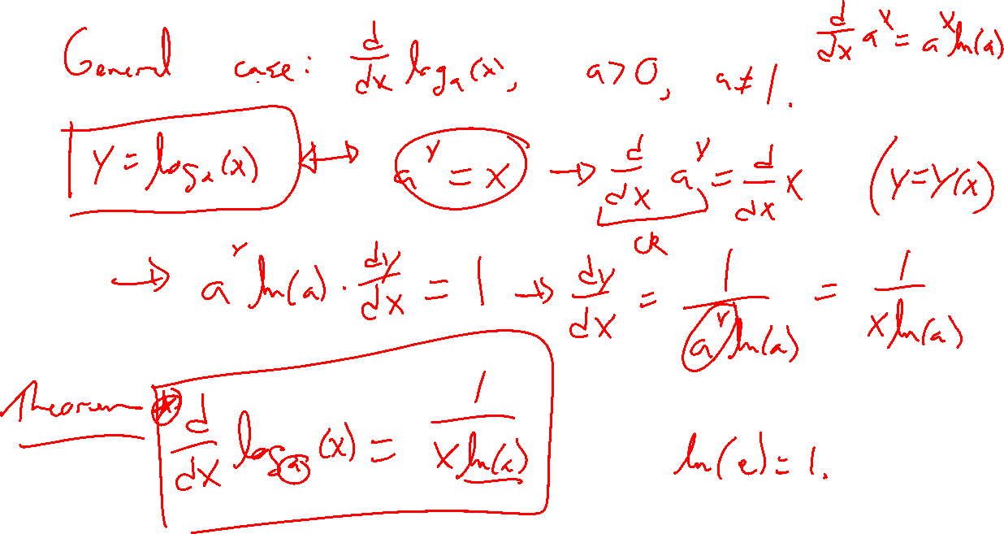

Slide 6
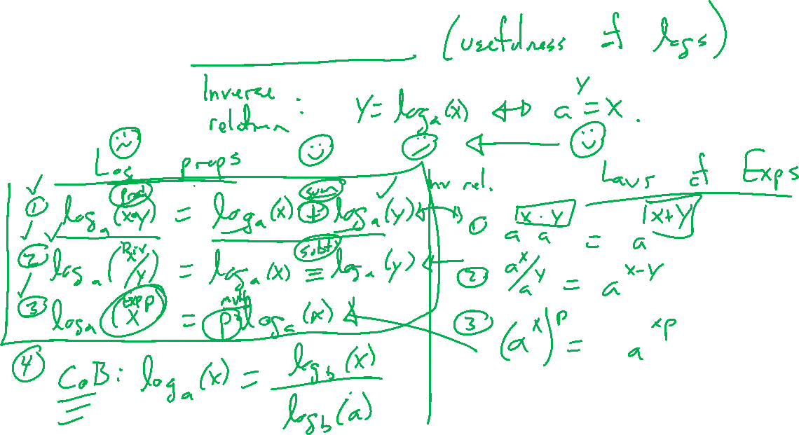
Recall: Log properties
Notes:
Real advantage of logs

Slide 7
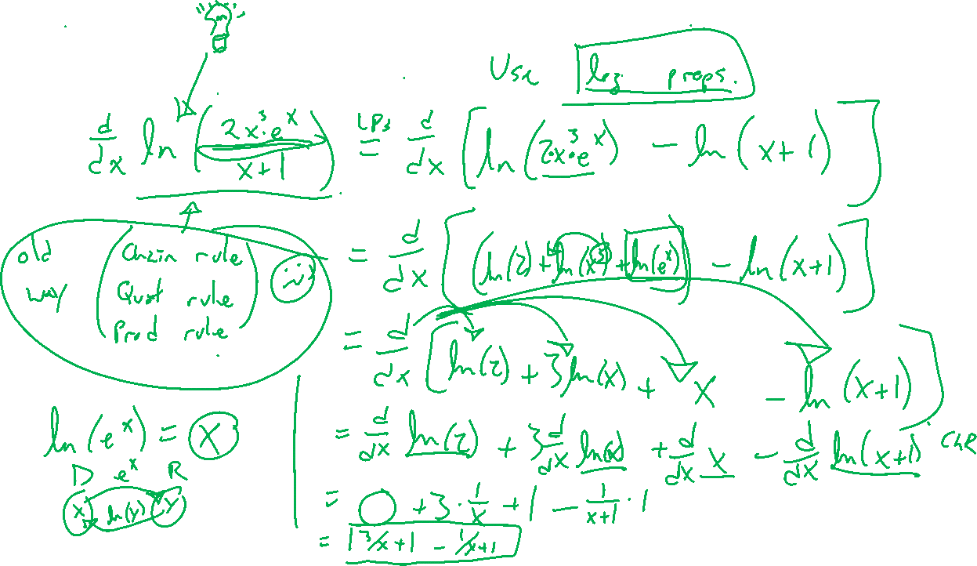
Example: Try on own
Notes:
D/dx ln(2x^3e^x) two ways

Slide 8
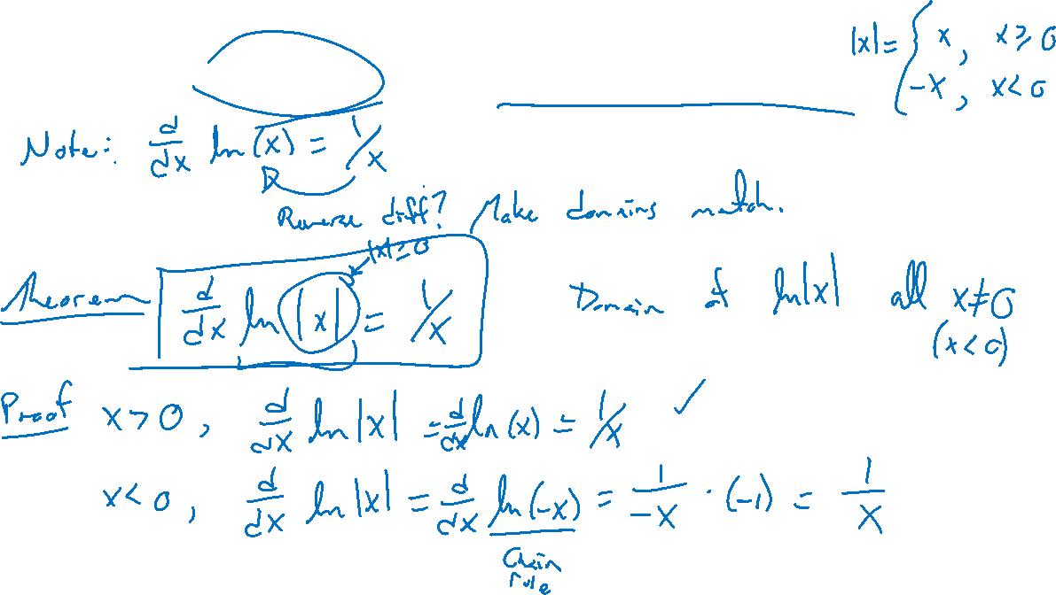
Example: Strange, but forward thinking
Notes:
D/dx ln|x| = 1/x, note domains match here

